Slide 1
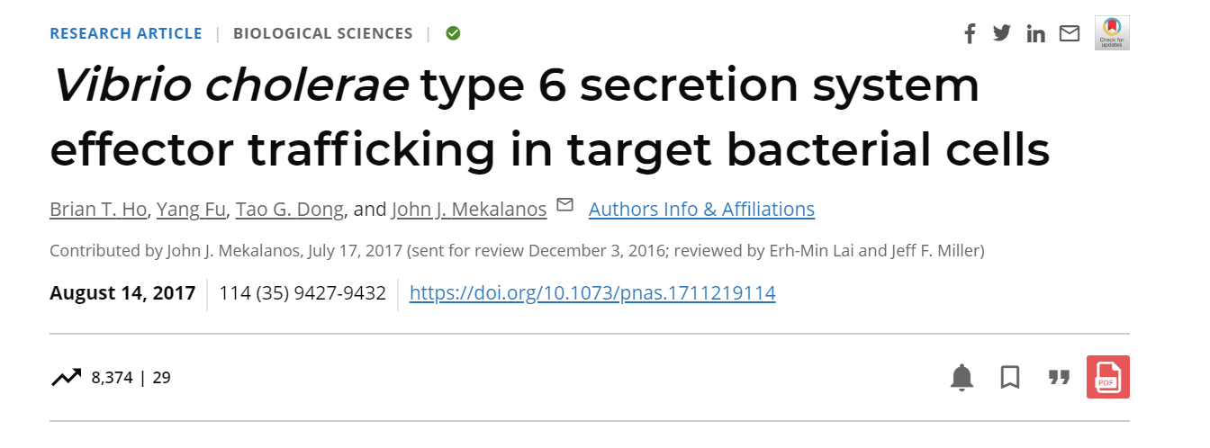
Vibrio cholerae type 6 secretion system effector trafficking in target bacterial cells

Slide 2
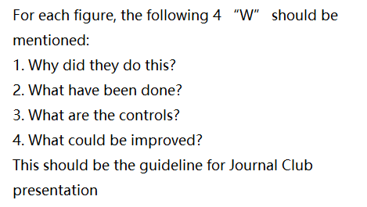

Slide 3
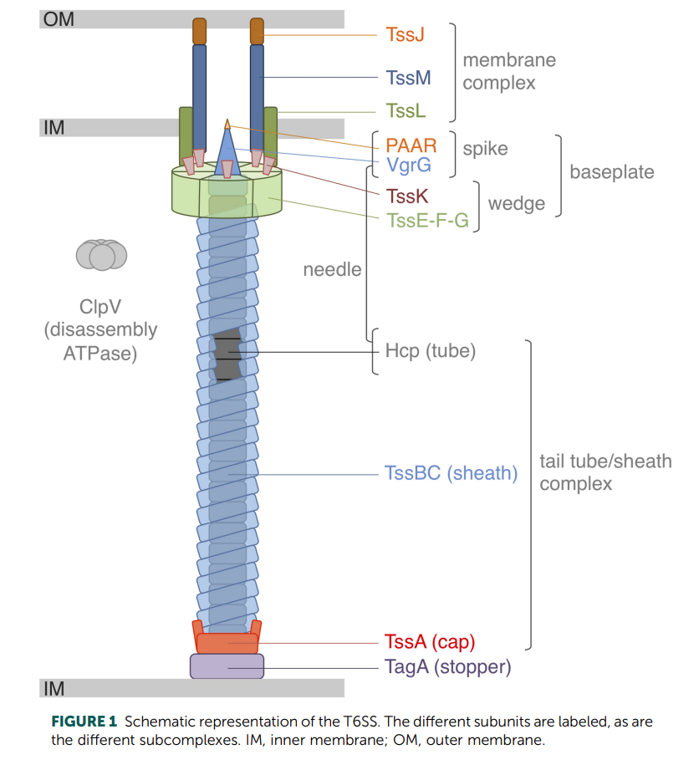
What is T6SS?
Structure
PAAR/VgrG-spike
Hcp-tube (represent ability of secretion)
Effector-usually toxic protein

Slide 4
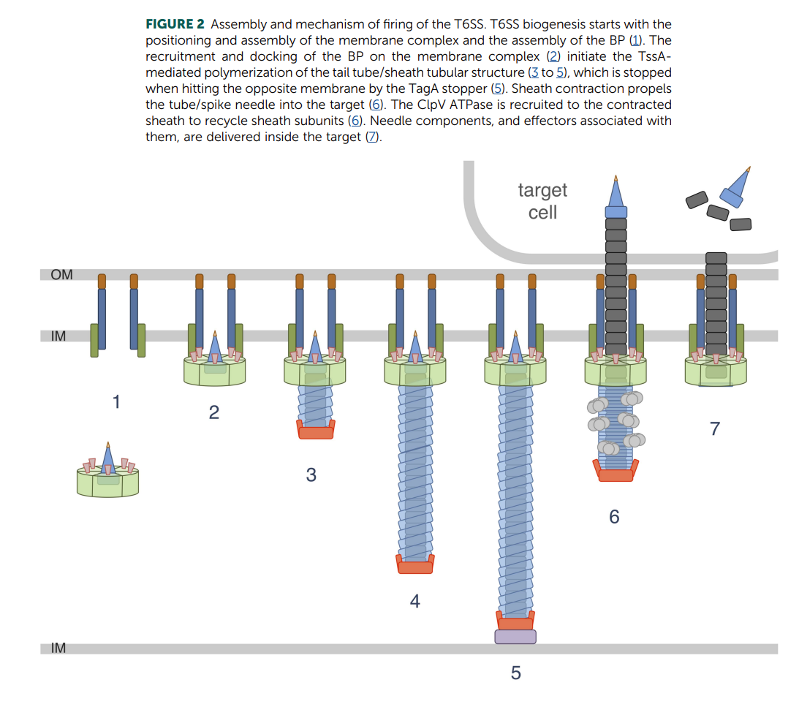
Process

Slide 5
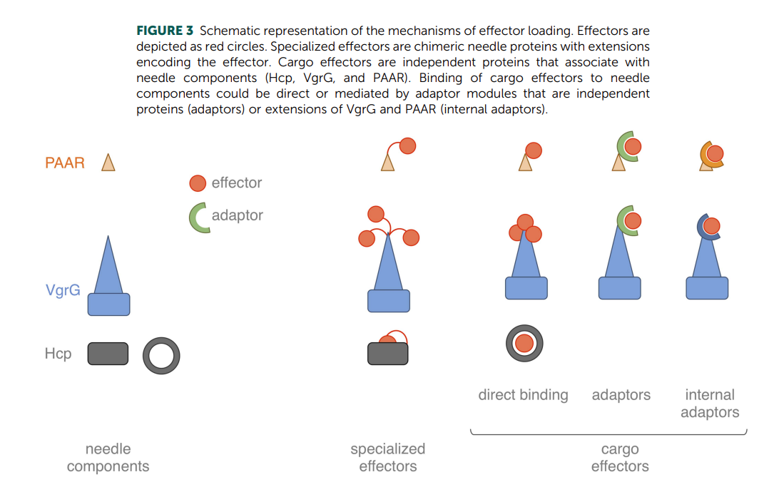
Function
Mostly important: protect them from outer biological pressure.
Others: involved in metal ion transport, response to oxygen stress, and regulation of intracellular pH in bacteria.
Effector:
1. peptidoglycan hydrolases, like VgrG3
2. nucleases, like RhsA
……

Slide 6
Background
Some effectors’ functions have been detected, which means we can know how they can use different effectors to lyse corresponding molecule and then speculate the final position they are delivered to.
Directly or indirectly?
Some evidence:
Recycling of T6SS substrates – ability to traffic back.
C-terminus effector may exchange horizontally – need to deliver to into different subcellular location.

Slide 7
Result
The lysozyme effector domain of VgrG3 can traffic from cytosol to periplasm.
The V. cholerae T6SS is capable of delivering effector domains into the cytosol.
A portion of the VgrG3 protein located in the linker region is responsible for delivery of an active, toxic effector to the periplasm.
The VgrG3 effector can be redirect.
The T6SS of V. cholerae is capable of delivering both homologous and heterologous effector domains directly to the target cell cytosol and that additional signals within these effectors can lead to their trafficking to other subcellular locations.

Slide 8
Three major experiments
Heterologous effector domain exchange
Induced mutant in E.coli and V. cholerae
Repeat experiments on other T6SS

Slide 9
Heterologous effector domain exchange
Guess on the first location of T6SS secretion.
The heterologous effector domain is toxic and can’t be trafficking(no signal sequence and is not conserve to S2/SD2 pyocins in recognize interaction).

Slide 10
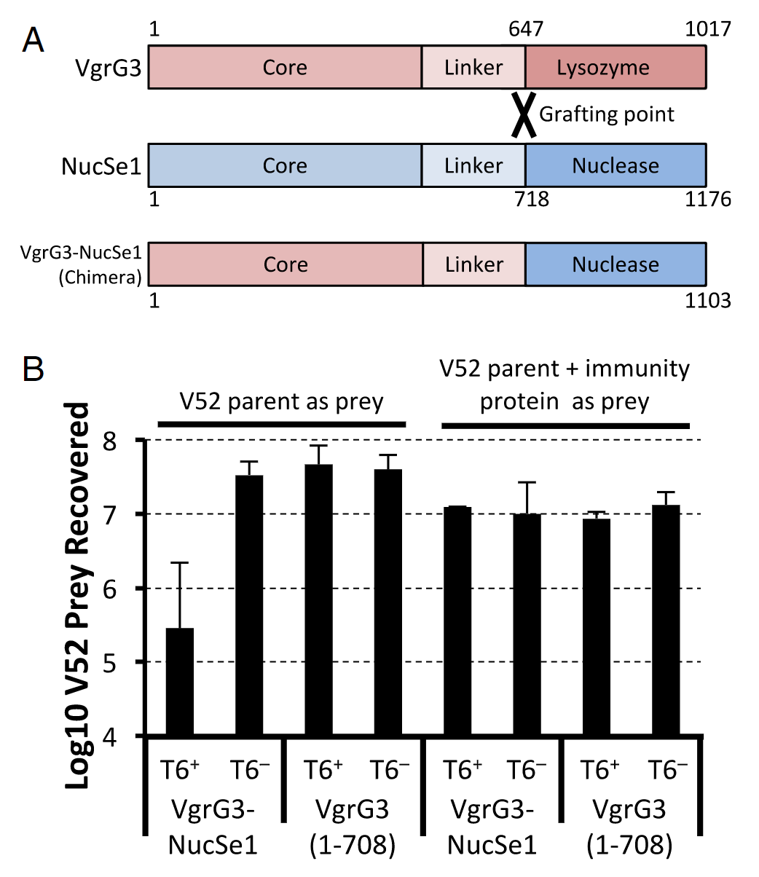
Control: only has core VgrG3 domain (VgrG3 (1–708))
(i) this putative Salmonella nuclease VgrG effector is a functional bacterial toxin that can be delivered by the heterologous V. cholerae T6SS;
(ii)a V. cholerae T6SS VgrG effector can serve as a scaffold for delivering heterologous effector domains from other bacterial species;
(iii)a V. cholerae T6SS VgrG is capable of delivering toxic effectors with both cytosolic and periplasmic targets into prey bacteria to kill them.

Slide 11
Induced mutant in E.coli and V. cholerae
Previous work: VgrG3 expressed in E.coli leads to cell death.
Reflect the existence of a trafficking signal that redirects cytosolic VgrG3 or its effector domain to the periplasm?
Or because the enzymatic domain might have an unexpected cytosolic target (such as a peptidoglycan pre-cursor) whose degradation might lead to cell death?

Slide 12
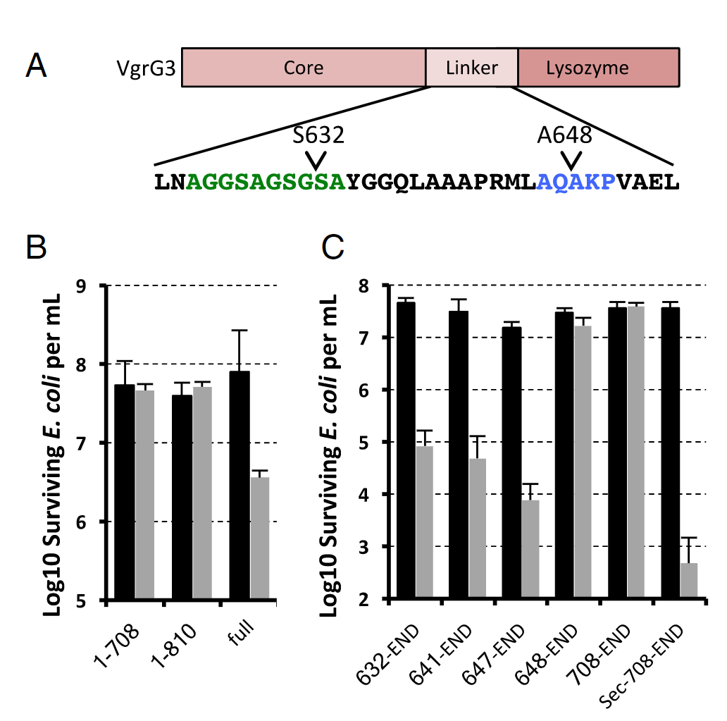
A series of truncation deletions removing the core VgrG domain and parts of the linker region connecting it to the enzymatic domain.
Two additional mutations consisting of the VgrG core domain truncated after the linker region (1–708) and at the lysozyme domain (1–810) to confirm that the VgrG core conferred no toxicity.

Slide 13
Vector: pBAD33
Induced in the presence of arabinose and repressed in the presence of glucose.
Performed immediately after a fresh transformation of the vector into E. coli DH10B to minimize passaging.
Colonies from this transformation were resuspended in LB, used to inoculate cultures containing either glucose or arabinose, grown for 2 h, and then serially diluted and plated to count cfus .

Slide 14
Core VgrG3 with part of lysozyme domain isn’t toxic.
Minimal domain that is toxic.
Add Sec-secretion signal to N-terminal, VgrG3 is still toxic.
Limitation: can’t detect VgrG3 directly because of cell lysis.
Improvement: look for periplasmic localization of VgrG3 within V. cholerae.

Slide 15
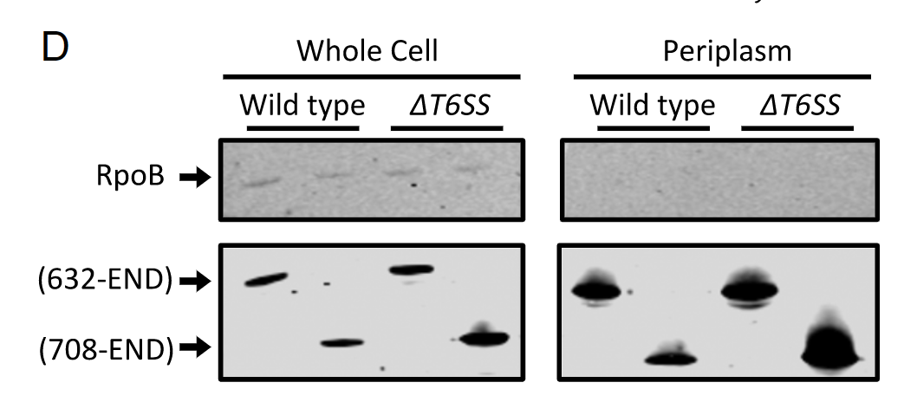
RNA polymerase beta subunit RpoB is a cytosolic protein used as a lysis control.
This localization was not dependent on the presence of the T6SS as a T6SS-negative Δvip A mutant exhibited similar VgrG3 localization.
Come up a question?
Whether the truncation mutant of VgrG3 that was not toxic (residues 708-END) might have lost its toxicity due to being trapped in the cytosol.

Slide 16
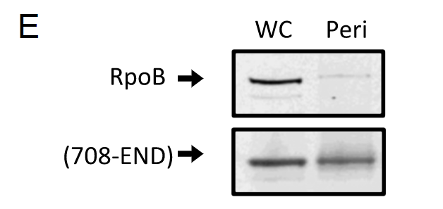
This nontoxic truncation mutant could also be found in the periplasm when expressed in E. coli.
Further confirmed that the 708-END construct was not toxic when expressed in a V. cholerae mutant lacking the cognate immunity protein of VgrG3.
708-END
648-708
toxicity
Sec-secretion

Slide 17
Rate limiting cytosolic proteolysis might be needed to release a highly toxic fragment of VgrG that contains both the periplasmic localization/activity signal and the intact lysozyme effector domain.

Slide 18
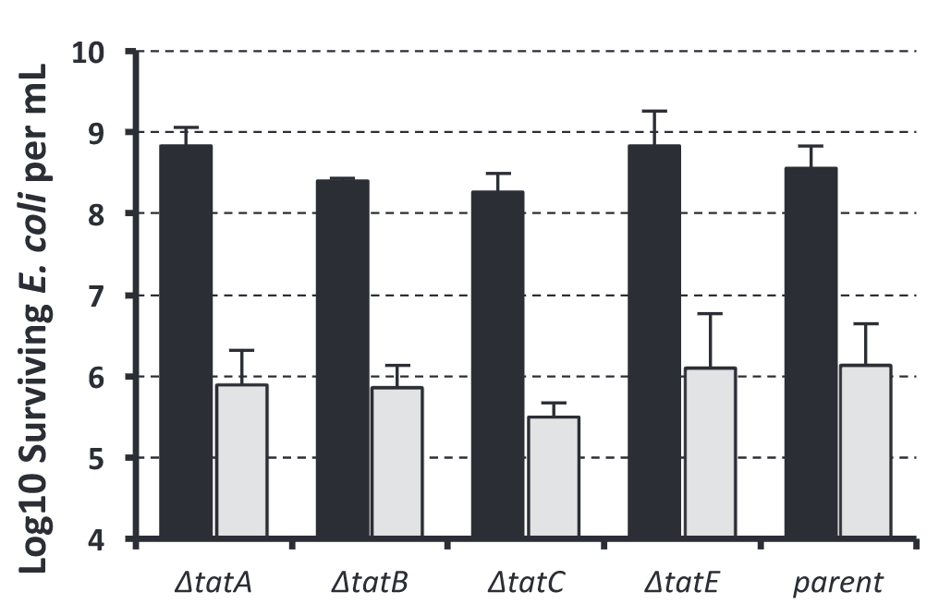
This region is actually predicted to be a Tat signal peptide despite lacking the conical twin arginine residues. (sequence neural-network prediction software TatP )
A-X-A motif
Some other secretion mechanism is likely re-sponsible for its periplasmic deliver.

Slide 19
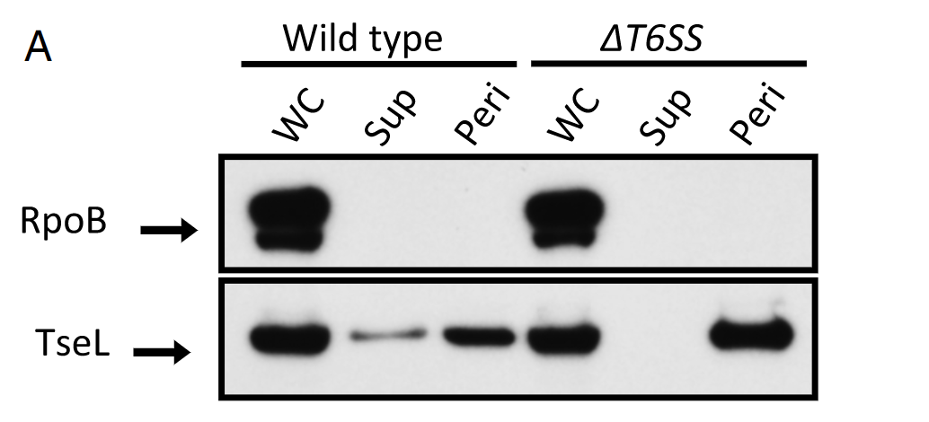
Repeat experiments on other T6SS
TseL has no predicted secretion signals, and although the precise subcellular target for either is not known, using PRED-TAT signal pre-diction software, its cognate immunity protein has a single predicted transmembrane domain near its N terminus and a predicted Sec-secretion signal.

Slide 20
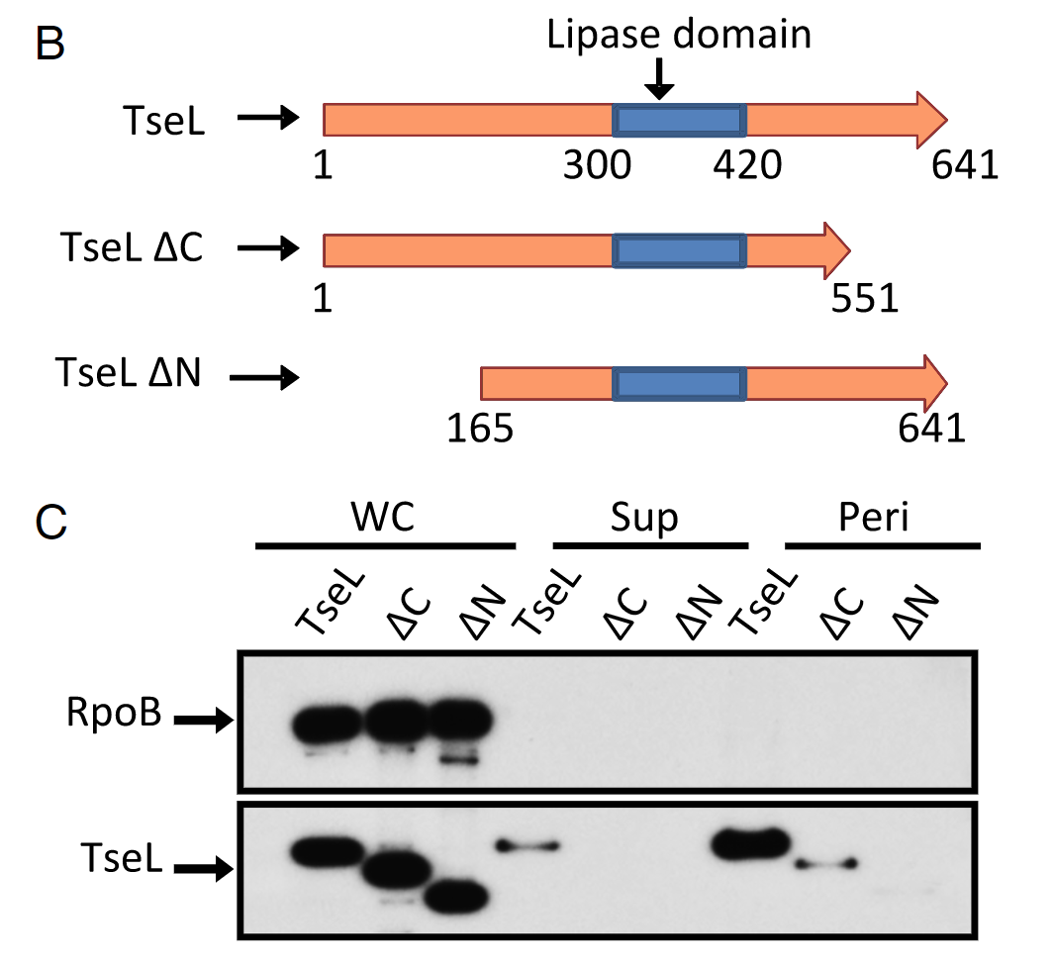
Made truncation mutants of the N and C termini before and after the lipase domain to see if we could identify a cryptic periplasmic localization signal.

Slide 21
Discussion
The fact that immunity proteins are so tightly linked with effector domains is further evidence that exchange may be occurring naturally.
There could be other mechanisms for translocation of these effectors into the cytosol.
One possibility worth considering is that the sequences within VgrG3 and the N-terminal region of TseL have intrinsic membrane-penetrating activity that allows certain protein domains to be translocated from cytosol to periplasm. This would allow some fraction of effector proteins that were delivered to the cytosol to reach the periplasm without needing to be recognized by the cellular machinery in the prey cell.

Slide 22
An innocuous organism (for example, alive, attenuated vaccine or commensal organism) can in theory be designed to kill either its pathogenic kin or a heterologous species by engineering these apathogenic organisms to express a toxic T6SSeffector domain that kills unwanted target pathogens lacking im-munity to the corresponding effector.

Slide 23
Reference
Ho, B.T. et al. (2017) “vibrio cholerae type 6 secretion system effector trafficking in target bacterial cells,” Proceedings of the National Academy of Sciences, 114(35), pp. 9427–9432. Available at: https://doi.org/10.1073/pnas.1711219114.
Cherrak, Y. et al. (2019) “Structure and activity of the type VI secretion system,” Microbiology Spectrum, 7(4). Available at: https://doi.org/10.1128/microbiolspec.psib-0031-2019.

